Slide 1


Sales Analysis of Superstore
Guided by; Presented by;
Dr. Deepa Kandpal Kinjal Panara
Yuti Tailor

Slide 2
Contains
About Data
Objectives
Market Basket Analysis
Findings
Appendix
References

Slide 3
About Data
Data of 3 years is provided by BIBirbal, for a superstore chain dealing in office products related to technology, office supplies and office furniture.
Type : Secondary
Size : No. of Rows - 6682
No. of Column – 23
Time Period : 2016-2018
Notes:
Secondary Data
3 segments and categories

Slide 4
Objective
Which type of customers should the company focus on?
Does the company need to continue to offer diversified products across a range of customers or should it consolidate products and/or customer base?
To study the data and try to forecast 2019 sales for 3 categories.
Notes:
Main 3 objectives
Related to customer and product behavior
Other to forecast sales for next year

Slide 5
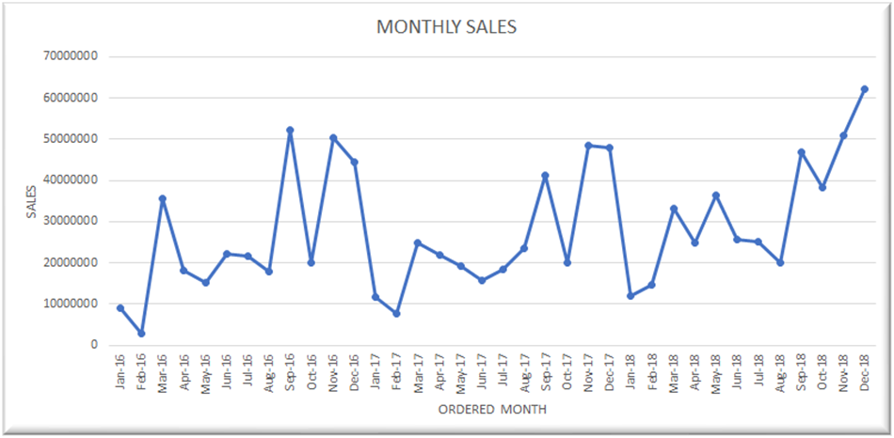
Objective : Forecasting Sales for 2019
Visualizing TS
Notes:
X-axis – Months of 2016 to 2018
Y-axis – Sales
Indication of seasonality and non linear trend

Slide 6
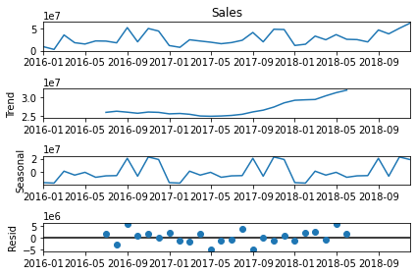
Decomposition of Time Series
The decomposition of a time series attempts to isolate individual components such as error, trend, and seasonality (ETS).
Notes:
TS repeating it self yearly
Non linear increasing trend

Slide 7
Stationarity Test
Statistical stationarity: A stationary time series is one whose statistical properties such as mean, variance are all constant over time.
Checked with Augmented Dickey-Fuller test

Slide 8
Steps of Model Building
We use a specific method to split the data called Walk-Forward validation.
(we take data from 2016 and 2017 as training data sets and 2018 as testing data sets)
Train-Test Split (2016,2017) – (2018)
Model fitting on (2016,2017)
Forecast 2018
Forecast 2019
Model Fitting for (2016,2017,2018)
Evaluation by RMSE
(original 2018 vs forecasted 2018)
Notes:
Walk-Forward validation

Slide 9
Evaluation of Models
Models:
Holt - Winters Method (HW Method)
Seasonal Autoregressive Integrated Moving Average (SARIMA)
Forecasting Furniture
For Categories Separately
Forecasting Technology
Final Forecasted Sales
Forecasting Overall Sales
Forecasting Office-Supplies
SARIMA
HW-Method
Over Full Data
Final Forecasted Sales
Notes:
Have used 2 models as TS contains Trend and Seasonality
Two ways to forecast overall sales
Choose best model base on RMSE for each 3 categories and over full data.
Final forecasted sales by forecasting separately and than sum of 3
Final forecasted sales by forecasting on full data

Slide 10
Comparison of Sales for 2018
Model to forecast Sales of 2018 | RMSE
For sum of three Categories | 1.033
For full Data | 1.102

Slide 11
Final Sales Forecasting for 2019
Quarters of 2019 | 95% C.I. for Average Sales (in Crores)
First Quarter | ( 0.15 , 3.92)
Second Quarter | ( 2.13 , 3.03)
Third Quarter | ( 0.87 , 5.37)
Fourth Quarter | ( 2.69 , 7.13)

Slide 12
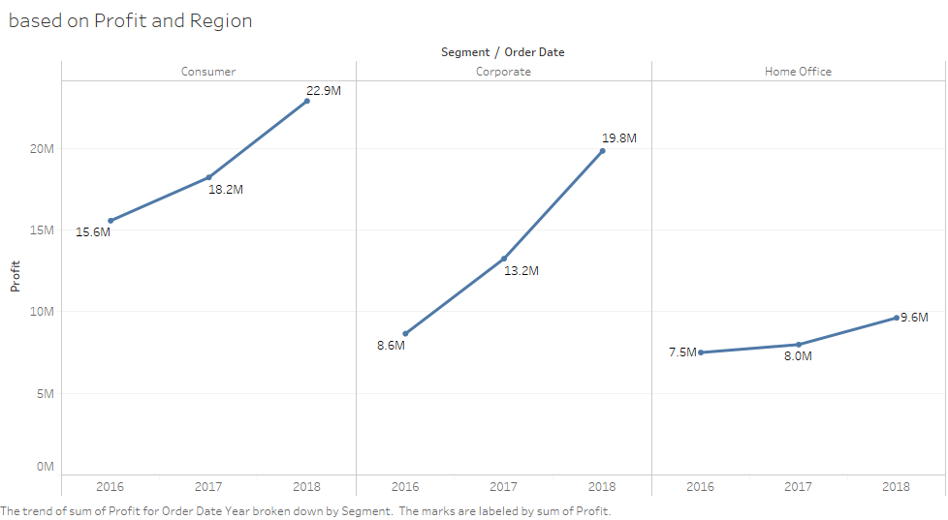
Objective : Analyzing Customer behavior
Customers are divided into mainly 3 types called segments (Consumer, Home Office and Corporate).
Around 46% of the profit is gained by the consumer segment.
Around 34% of the profit is gained by the Corporate segment.
Around 20% of the profit is gained by the Home Office segment.
Notes:
Which type of customers should the company focus on for the next 3 years?
Increasing customer behavior over given 3 years
Segment home office haven’t increase in gaining much profit over 3 year

Slide 13
ABC Analysis on Profit
A (Total 70% Profit) | B (Remaining 20% Profit) | C (last 10% Profit) | Total Customer
167 | 167 | 290 | 624
From Total 70% Profit
31%
50%
19%
Notes:
Sum of Profit for each Customer ID. Color shows sum of Profit. The markers are labeled by % of Total Profit.
For 70%
Corporate : 52 (in quantity) : 31%
Consumer : 82 (in quantity) : 50%
Home Office : 31 (in quantity) : 19%
Total 167 (in quantity) : 100%

Slide 14
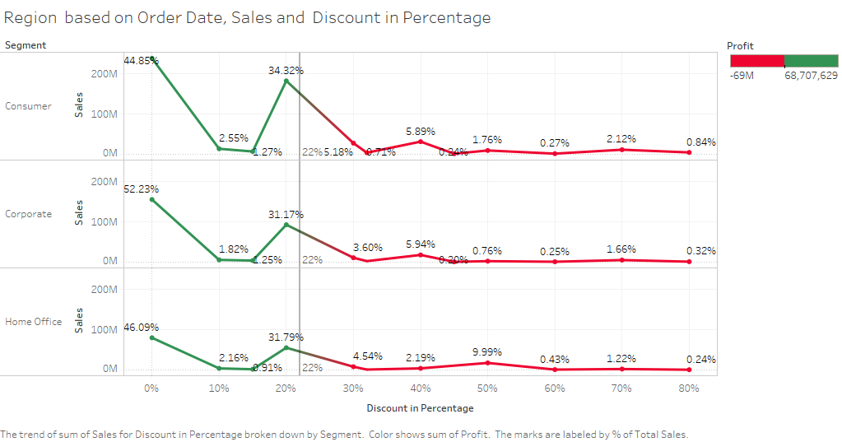
Segment behavior with Discount
Correlation between Discount and Profit is (-0.22).
Not strong but negative correlation.
Notes:
X-axis - Discount
Y-axis – Segments and Sales
Percentage – Sales
Colour – Profit ( Green-Profit , Red-loss)
Less or no discount more sales and profit
Negatively correlated -0.2.

Slide 15
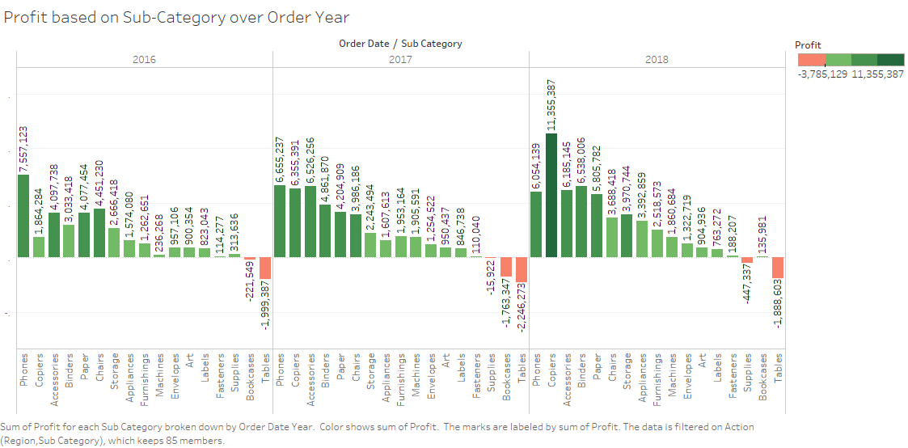
Objective : Analyzing Product behavior
Products are divided into mainly 3 types called Category (Furniture, Office Supplies and Technology).
And these Category are divided into Sub-Category as:
Furniture: Chairs, Furnishings, Bookcases and Tables.
Office Supplies: Binders, paper, storage, Appliances, Envelopes, Art, Labels, Fasteners and Supplies.
Technology: Phone, Copies, Accessories and Machines.
Notes:
Objective 3: Does the company need to continue to offer diversified products across a range of customers or should it consolidate products and/or customer base?
X-axis – Year and subcategory
Y-axis – Profit
Color - Profit and loss
Phones and copier gaining sig profit over the years
Tables are making loss throughout 3 years
Rate of profit increases throughout given years
Technology: Copies
Office Supplies: Binders, paper, Appliances, Envelopes
Furniture: Furnishings,
Rate of profit decreases throughout given years
Technology: Phone (although it makes profit)
Office Supplies: Supplies (it makes loss)
Furniture: Chairs (although it makes profit)
Rate of profit 1st decreases (in 2017) and then increases (in 2018) in given years
Technology: --
Office Supplies: storage, Fasteners
Furniture: Bookcases, Tables
Rate of profit 1st increases (in 2017) and then decreases (in 2018) in given years
Technology: Accessories, Machines
Office Supplies: Art, Labels,
Furniture: --
Tables do not make profit over given years that are 2016,2017,2018.

Slide 16
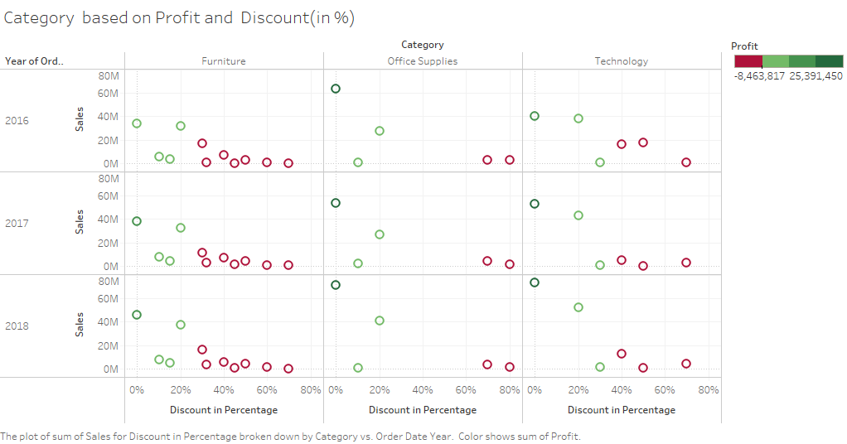
Product behavior with Discount
Around 49% of the profit is gained by the Category Technology.
Around 43% of the profit is gained by the Category Office Supplies.
Around 8% of the profit is gained by the Category Furniture.
Notes:
X-axis - Discount
Y-axis – Segments and Sales
Percentage – Sales
Colour – Profit ( Green-Profit , Red-loss)
Less or no discount more sales and profit
Negatively correlated -0.2.

Slide 17
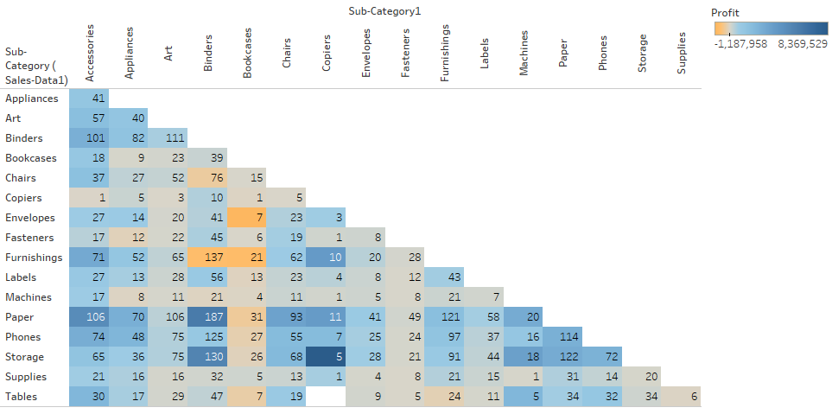
Market Basket Analysis
(Copier, Storage) : 005
(Papers, Binders) : 187
(Furnishings, Binders) : 137
(Phones, Paper) : 114
(Phones, Binders) : 125
Notes:
(Copier, Storage) : 005 [Low selling but most profit gaining pair]
(Papers, Binders) : 187 [Most selling pair with profit]
(Phones, Paper) : 114 [Rare pair with profit as well as good selling quantity]
(Phones, Binders) : 125 [Rare pair with more selling quantity but lesser profit than papers and phones]
(Furnishings, Binders) : 137 [2nd highest selling pair with most lose]

Slide 18
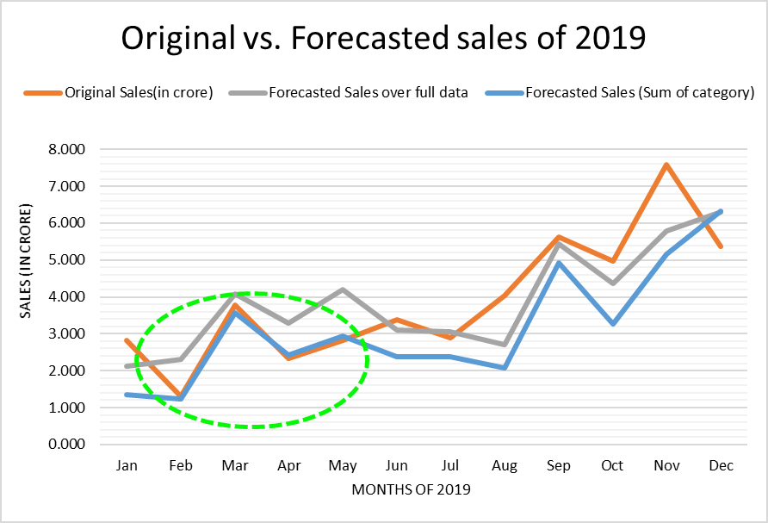
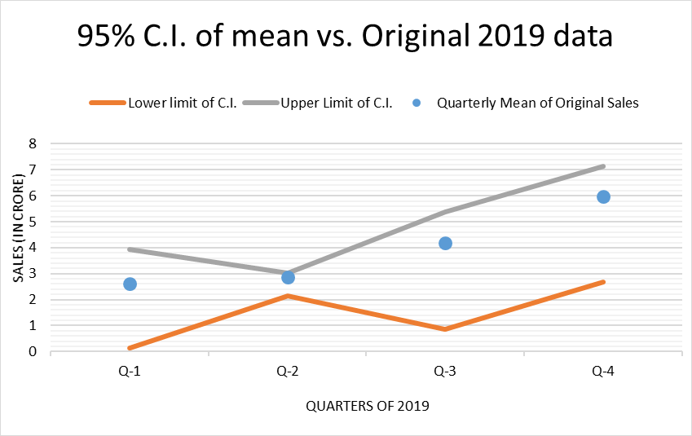
Findings
Forecasting for categories separately provides better results than forecasting on overall data.

Slide 19
Findings
Discount more than 0.2% have more chances of resulting into loses.
Customer who purchase paper or binders also purchase phones and profit is gain from it too.
ABC analysis for products. Following table shows number of products for each class.
A (Total 70% Profit) | B (Remaining 20% Profit) | C (last 10% Profit) | Total Products
206 | 349 | 944 | 1499
Notes:
Don’t give discount on all products from same basket

Slide 20
Appendix
[ 1 ] HTML file of python code for the first objective:
File Name: objective1_Forecasting Sales for 2019
[ https://drive.google.com/file/d/1PwuMzrJlwTDXzg8xbhLENV4Eel6P7A1f/view?usp=sharing ]
[ 2 ] Excel file of ABC inventory analysis
File Name: data_Profit - Category and Region
[ https://drive.google.com/file/d/1S5x4arcHqnVl0TxiYnaiaJl3COL0Xi8Z/view?usp=sharing ]
[ 3 ] Tableau file of Objective 3
File Name: objective_3_ParetoChart
[ https://drive.google.com/file/d/1g82s14CARZ5jDkuuBCBUderWKBLgOkVQ/view?usp=sharing ]
[ 4 ] Tableau file of Market Basket analysis
File Name: 5_Market_Basket_Analysis
[ https://drive.google.com/file/d/1Y653jXU9z2q_QKloc64vT-Abhp-MpWgp/view?usp=sharing ]

Slide 21
Data fields
Attributes |  | Columns Names | Brief Description
Date | <-> | Order Date | Date of Order
 |  | Ship Date | Date when shipped
 |  | Payment Date | Date of Payment
Customer | <-> | Customer ID | Customer Identification
 |  | Customer Name | Customer Name
Country | <-> | City | City where customer shopped
 |  | State | State where customer shopped
 |  | Region | Region of City/State
 |  | Country | Country of City/State
Product | <-> | Product ID | Product id of item shopped
 |  | Product Name | Product name
Product Group / Business Line | <-> | Segment | Segment to which the customer belongs to
 |  | Category | Category to which the product belongs to
 |  | Sub-Category | Sub Category to which the product belongs to
Sales Amount | <-> | Sales | Sales amount or order
Sales Margin | <-> | Profit | Profit or margin at product level
Sales Quantity | <-> | Quantity | Quantity of item sold
Discount | <-> | Discount (in %) | Discount in percentage
Sales Person Id | <-> | Sales Person ID | Sales person id
Sales Person | <-> | Sales Person Name | Sales person name
Credit Days | <-> | Credit Days | Payment terms of extending credit
Order Id | <-> | Order ID | Order Id
Ship Mode | <-> | Ship Mode | Mode of Shipment

Slide 22
References
[ Smoothing Techniques for time series data | by Sourav Dash | Medium]
[ An overview of time series forecasting models | by Davide Burba | Towards Data Science ]
[ Akaike Information Criterion | When & How to Use It (scribbr.com) ]
[https://machinelearningmastery.com/introduction-to-time-series-forecasting-with-python/ ]
[https://www.studytonight.com/post/what-is-mean-squared-error-mean-absolute-error-root-mean-squared-error-and-r-squared ]
[ https://anomaly.io/seasonal-trend-decomposition-in-r/index.html ]
[https://stats.stackexchange.com/questions/333092/why-i-get-the-same-predict-value-in-arima-model ]
[ What is Mean Squared Error, Mean Absolute Error, Root Mean Squared Error and R Squared? - Studytonight ]

Slide 23
Thank You !

